Slide 1
Unit 11: Intro to Time Series via Holt Winters

Slide 2
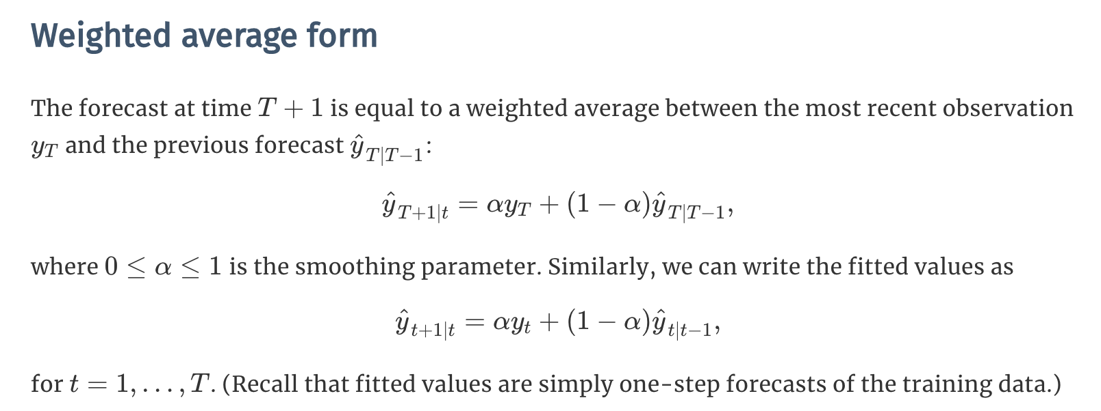
SES: Weighted Average Form

Slide 3
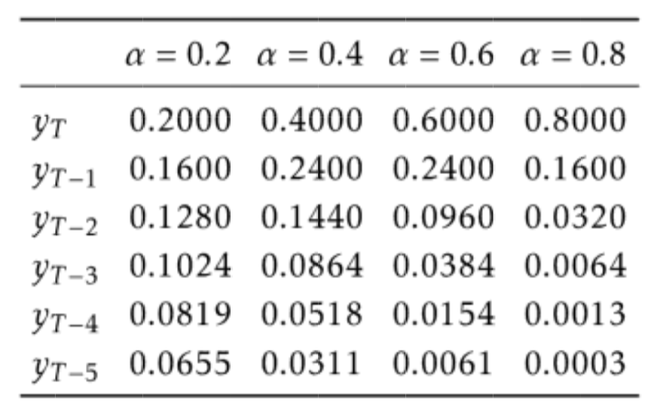
Simple Exponential Smoothing
https://robjhyndman.com/hyndsight/aic/

Slide 4
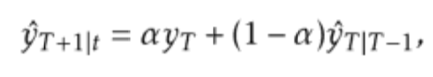

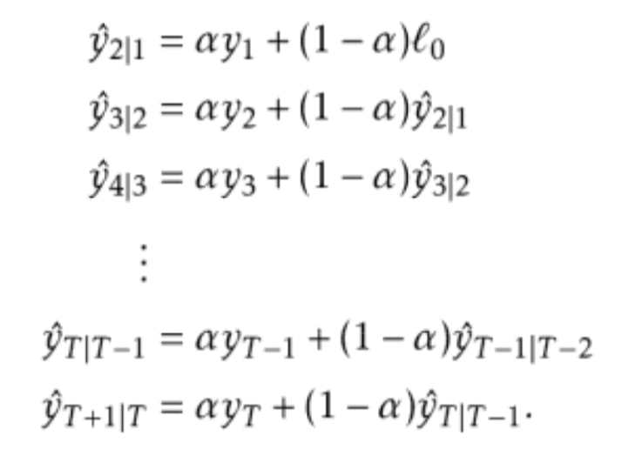
Simple Exponential Smoothing

Slide 5
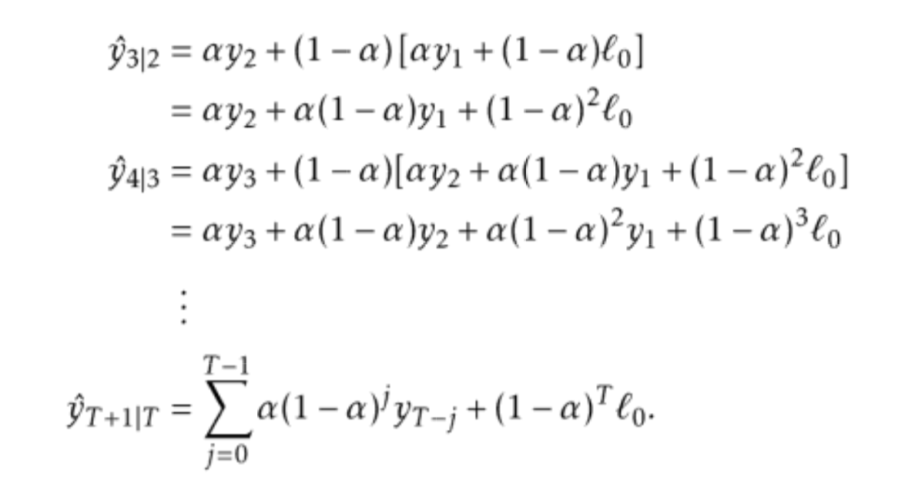
Simple Exponential Smoothing

Slide 6
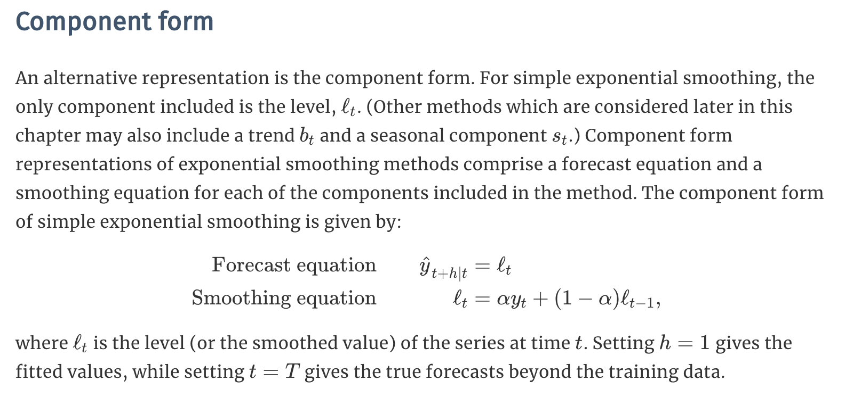
Component Form

Slide 7
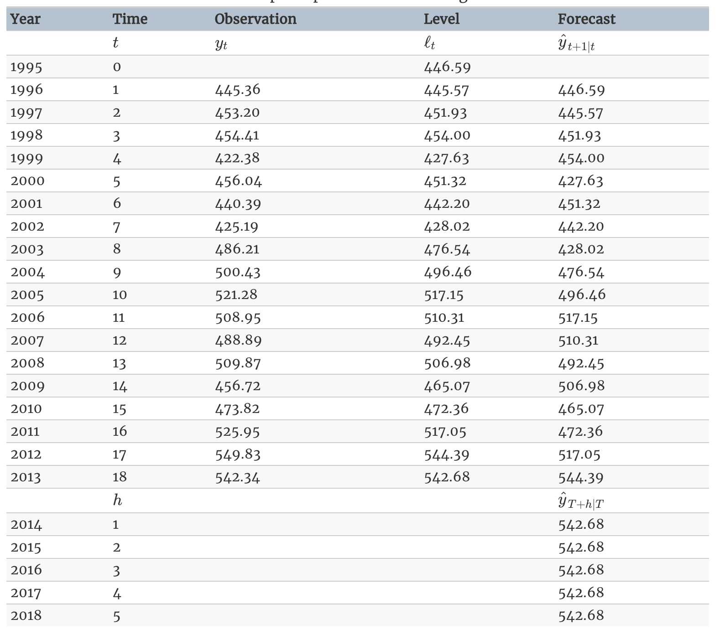
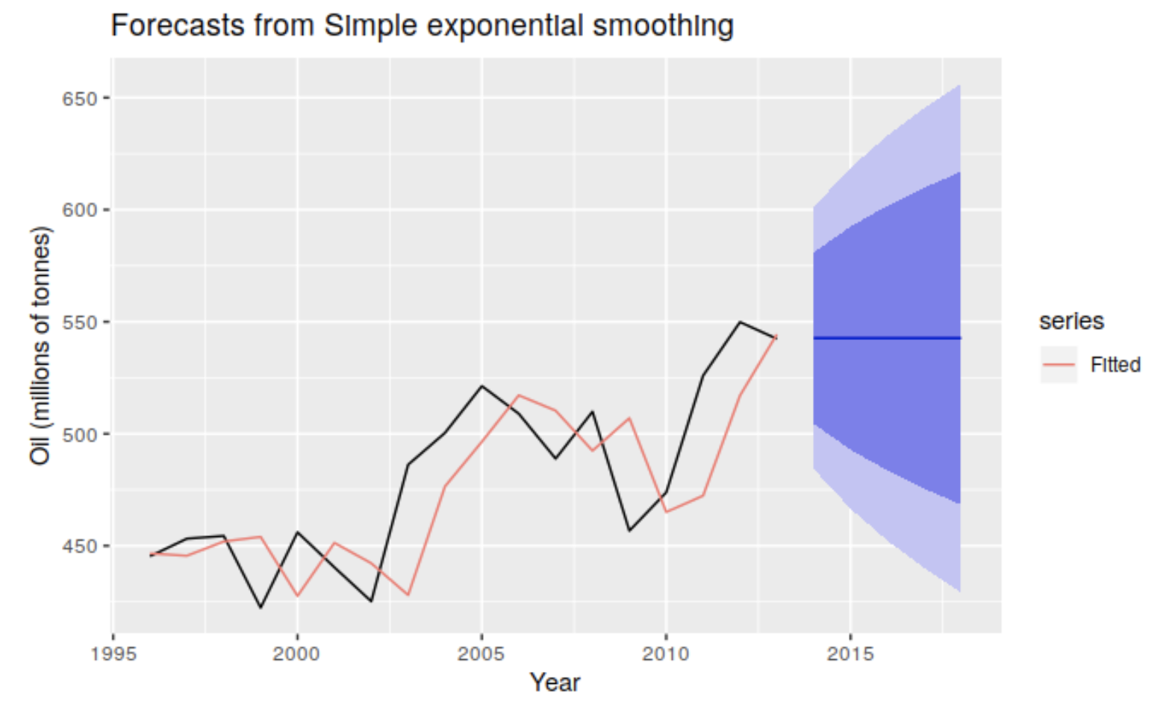
Example: SES

Slide 8
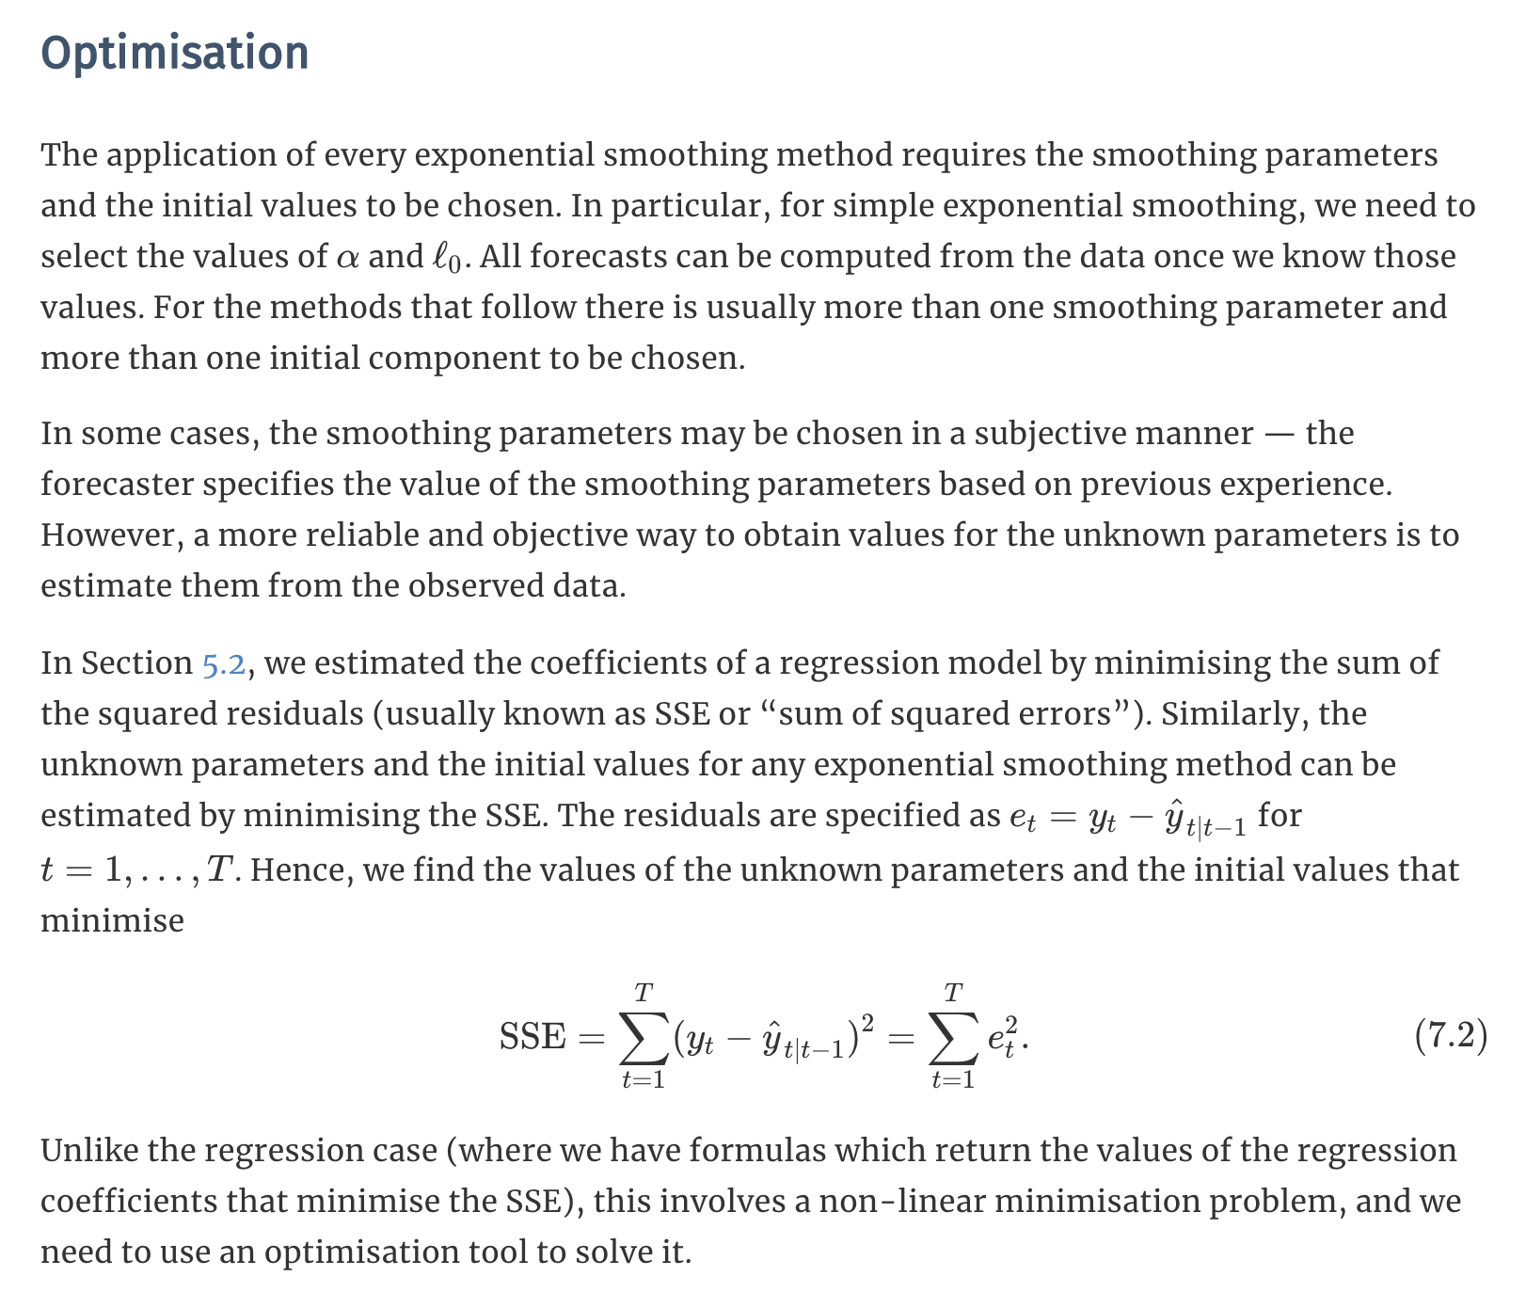
Optimization

Slide 9
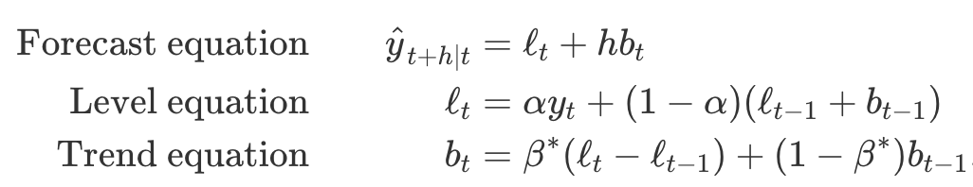
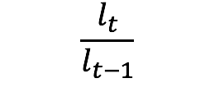

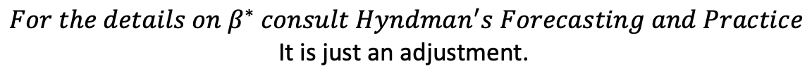
HOLT Linear Trend
Additive
Multiplicative
$${For the details on β}^{∗} consult Hyndman^{′}s Forecasting and Practice$$
It is just an adjustment.

Slide 10
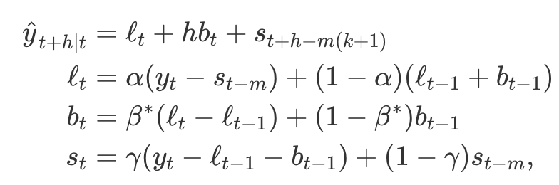
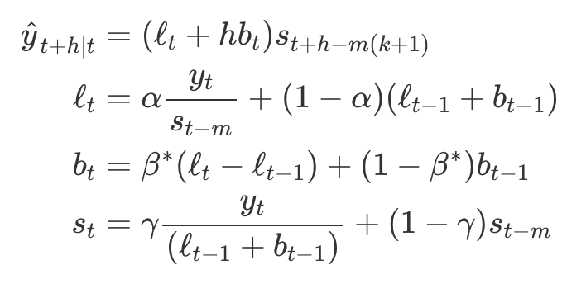
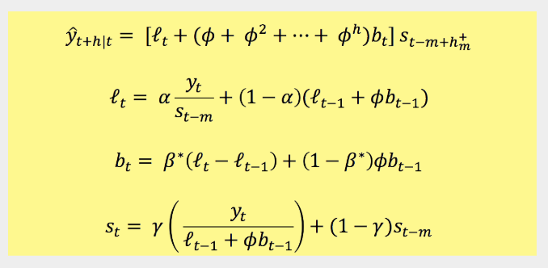
Holt Winters Seasonal Model
m = frequency of the seasonality …
m = 12 for monthly data
m = 4 for quarterly data
Additive
Multiplicative

Slide 11
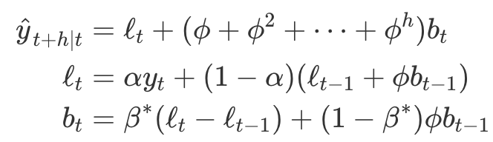
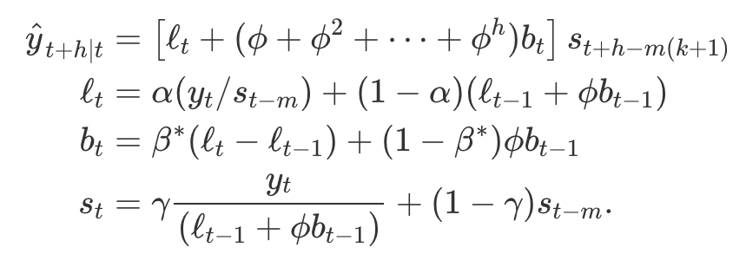
Damped Additive and Multiplicative
Damped Additive Holt
Damped Multiplicative Holt Winters

